Slide 1

Minor Project Presentation
PREDICTION OF COVID-19 FROM CHEST X-RAY
AND COVID-19 TRACKER
EVALUATING PANEL:
Dr. Nonita Sharma
Dr. Krishna Pal Sharma
SUBMITTED BY:
Rajan Kataria (18103076)
Rippendeep Kaur (18103078)
Sanyamdeep Singh (18103083)
Department of Computer Science and Engineering
Dr B R Ambedkar National Institute of Technology Jalandhar

Slide 2
Problem Statement and Necessity
Lack of Accessibility to Sample Collection/Testing Centers
There are many people who are unable to get themselves tested in the hospitals or other COVID-19 sample collection/testing centers.
Delay in the Test Report
The RT-PCR test is considered as the most reliable test for the detection of the COVID-19 infection. But this test itself has some drawbacks. The report comes after 72 hours of sample collection and within these 72 hours the person is unsure whether he/she is infected or not.
Unavailability of Doctor
A patient can get himself detected in case he/she is unable to get an appointment with the doctor as per the current scenario of the country. In such a case he/she can perform a self-test using the image of his/her chest x-ray.

Slide 3

Proposed Solution: COVID-19 Predictor
We have developed a web application using which an individual can predict whether he/she is COVID 19 Positive or Negative just by uploading the image of Chest X-RAY.
It can be very helpful to reduce the spread of this disease by early automated diagnosis.

Slide 4


Usage: Stakeholders
Using the web application, an individual can have a self COVID test at home after getting an X_RAY image from the Lab, as actual COVID-19 test report takes 72 hours to arrive.
This technique can also be useful to clinicians as a treatment plan that can be used depending on the type of infection and can provide prompt decisions.

Slide 5
Feasibility Study
TECHNICAL FEASIBILITY:
Web Application Supporting Devices as mobiles, tablets, desktops, laptops.
Internet connectivity is required for the system.
Chest X-ray Image is required in jpg/png format.
NON-TECHNICAL FEASIBILITY:
SOCIAL:
No such software are available with higher accuracy.
It will make the COVID-19 detection easier and feasible.
It will support the digitization movement started by Honorable Prime Minister of India.
ECONOMICAL FEASIBILITY:
This project doesn’t require any cost in development.
This software is available freely to be used by any person making COVID-19 detection economically feasible for all.

Slide 6











Tech Stack

Slide 7
Image Processing
Image processing aims to transform an image into digital form and performs some process on it, to get an enhanced image or take some utilized information from it.
It is a method that develops to convert the image into digital form and perform some operations to obtain specific models or to extract useful information from it
WHY WE USE IT?
• Image sharpening and restoration
• Pattern recognition.
• In developing games.
• Human position tracking
• In medical field(X-RAY, MRI, CT-SCAN)

Slide 8
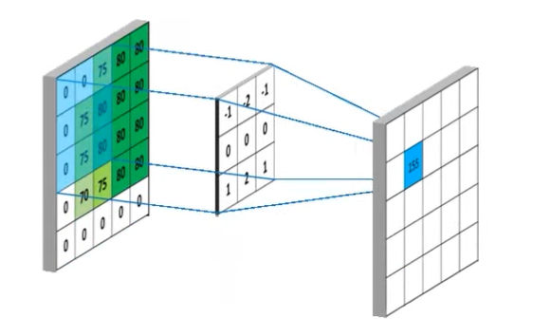
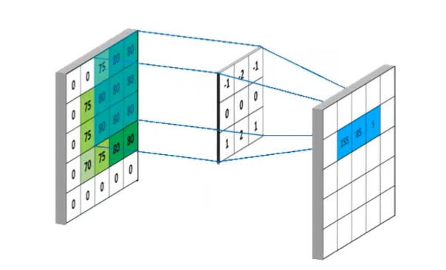
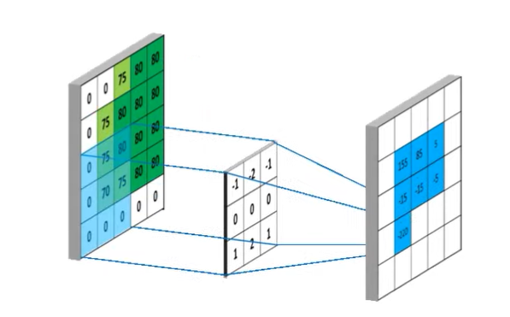
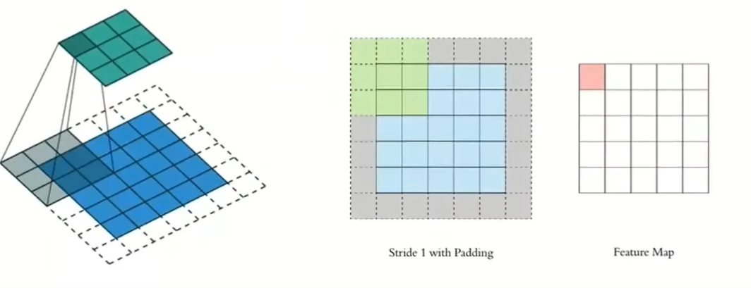
Image processing: Concepts (1)
1.) Image Filtering: It is a process of modifying an image by changing its shades or color of the pixel. A kernel/filter goes all over the points of spatial domain of the images and gives us special points as output.
2.) Padding: It is a term relevant to Convolutional neural network as it refers to the amount of pixel added to an image when it is being processed by kernel or filter to avoid the loss of important information.

Slide 9
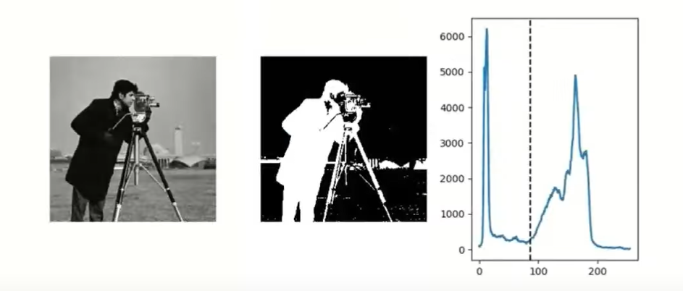
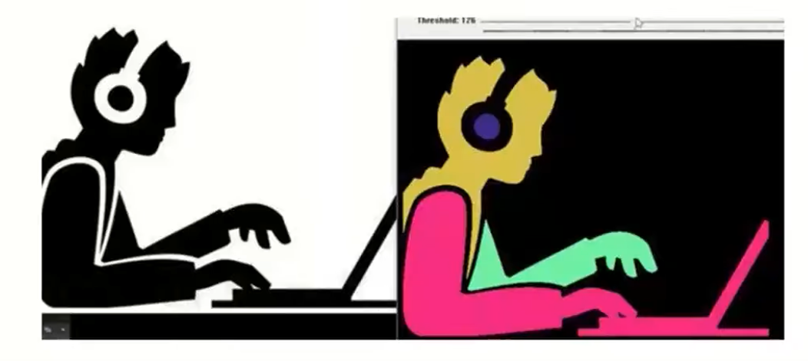
Image processing: Concepts (2)
3.) Image thresholding: Everything is converted to black and white based on the threshold value.
4.) Connected Components: Connected components labelling scans an image and group its pixels into components based on pixel connectivity i.e. all pixels in a connected component share similar pixel intensity values.

Slide 10
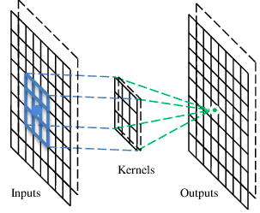
Convolutional Neural Networks
A CNN is a neural network with some convolutional layers (and some other layers). A convolutional layer has a number of filters that does convolutional operation.

Slide 11
Convolution Concepts (1)
These are the network parameters to be learned
1 | 0 | 0 | 0 | 0 | 1
0 | 1 | 0 | 0 | 1 | 0
0 | 0 | 1 | 1 | 0 | 0
1 | 0 | 0 | 0 | 1 | 0
0 | 1 | 0 | 0 | 1 | 0
0 | 0 | 1 | 0 | 1 | 0
1 | -1 | -1
-1 | 1 | -1
-1 | -1 | 1
-1 | 1 | -1
-1 | 1 | -1
-1 | 1 | -1
6 x 6 image
……
Each filter detects a small pattern (3 x 3).

Slide 12
Convolution Concepts (2)
1 | 0 | 0 | 0 | 0 | 1
0 | 1 | 0 | 0 | 1 | 0
0 | 0 | 1 | 1 | 0 | 0
1 | 0 | 0 | 0 | 1 | 0
0 | 1 | 0 | 0 | 1 | 0
0 | 0 | 1 | 0 | 1 | 0
Dot
product
3
-1
1 | -1 | -1
-1 | 1 | -1
-1 | -1 | 1
Filter 1
6 x 6 image

Slide 13
Convolution Concepts (3)
If stride=2
1 | 0 | 0 | 0 | 0 | 1
0 | 1 | 0 | 0 | 1 | 0
0 | 0 | 1 | 1 | 0 | 0
1 | 0 | 0 | 0 | 1 | 0
0 | 1 | 0 | 0 | 1 | 0
0 | 0 | 1 | 0 | 1 | 0
3
-3
1 | -1 | -1
-1 | 1 | -1
-1 | -1 | 1
6 x 6 image
Filter 1

Slide 14
Convolution Concepts (4)
1 | -1 | -1
-1 | 1 | -1
-1 | -1 | 1
Filter 1
stride=1
1 | 0 | 0 | 0 | 0 | 1
0 | 1 | 0 | 0 | 1 | 0
0 | 0 | 1 | 1 | 0 | 0
1 | 0 | 0 | 0 | 1 | 0
0 | 1 | 0 | 0 | 1 | 0
0 | 0 | 1 | 0 | 1 | 0
3
-1
-3
-1
-3
1
0
-3
-3
-3
0
1
6 x 6 image
3
-2
-2
-1

Slide 15
Convolution Concepts (5)
stride=1
1 | 0 | 0 | 0 | 0 | 1
0 | 1 | 0 | 0 | 1 | 0
0 | 0 | 1 | 1 | 0 | 0
1 | 0 | 0 | 0 | 1 | 0
0 | 1 | 0 | 0 | 1 | 0
0 | 0 | 1 | 0 | 1 | 0
Repeat this for each filter
3
-1
-3
-1
-1
-1
-1
-1
-3
1
0
-3
-1
-1
-2
1
Feature
Map
-3
-3
0
1
-1
-1
-2
1
6 x 6 image
3
-2
-2
-1
-1
0
-4
3
-1 | 1 | -1
-1 | 1 | -1
-1 | 1 | -1
Filter 2
Two 4 x 4 images
Forming 2 x 4 x 4 matrix

Slide 16
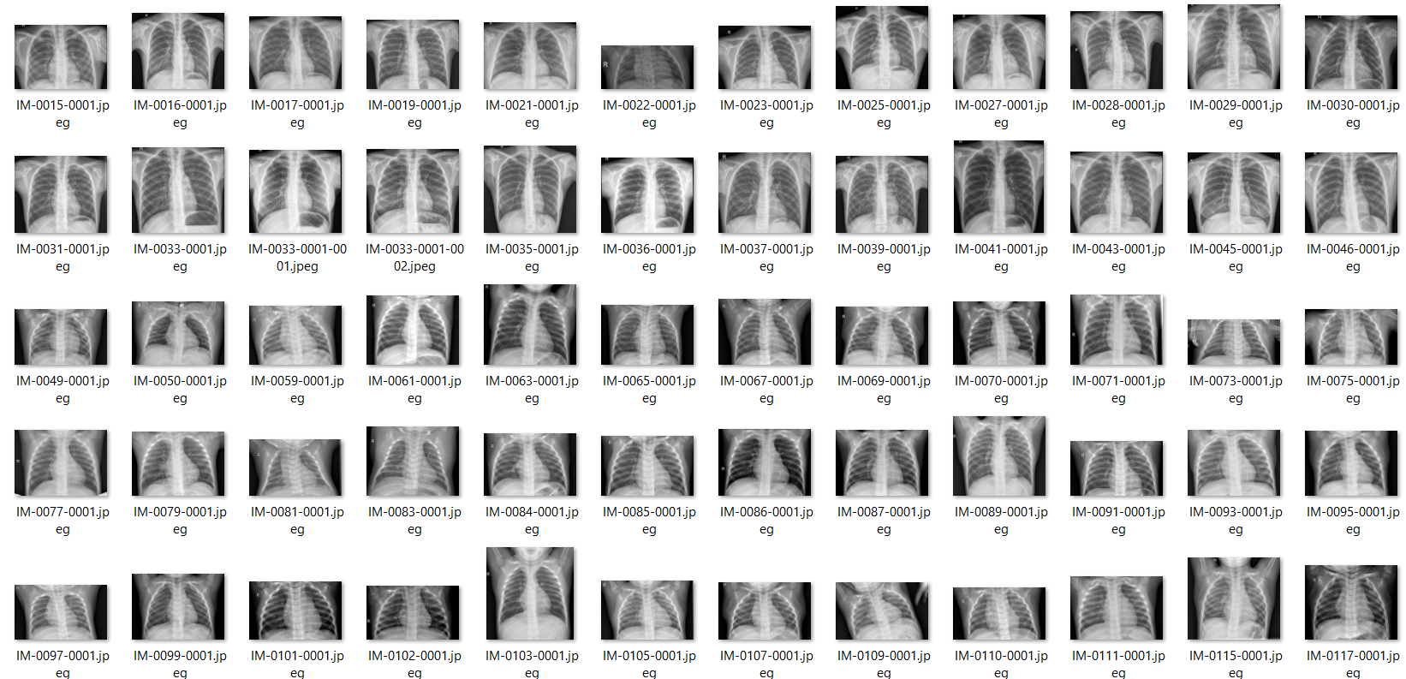
Machine Learning Model: Preprocessing
Creating the Customized dataset from two parent datasets.
Preprocessing of the dataset
Conversion of images from BGR to grayscale format
Resizing the images
Normalization

Slide 17
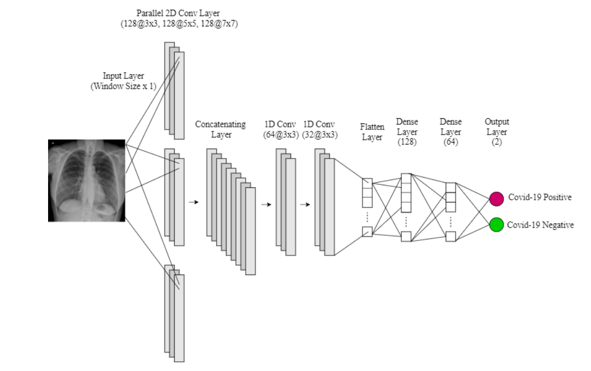
Machine Learning Model: CNN training

Slide 18
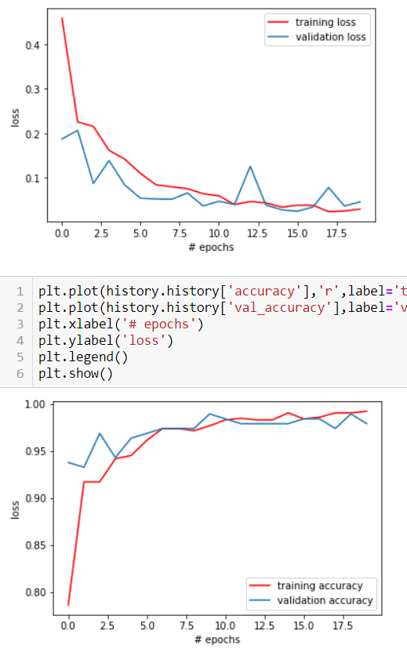
Machine Learning Model: Results & Accuracy
The accuracy achieved by the CNN model after running 20 epoches on testing set is 99.07% and the loss is 3.10%.

Slide 19
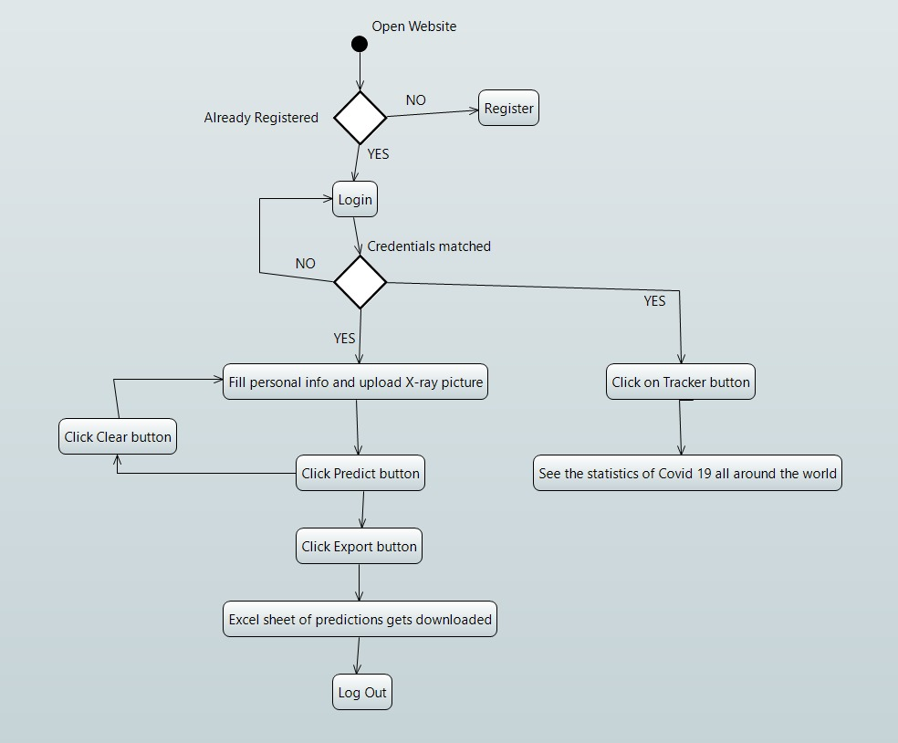
Web Application: Activity Diagram

Slide 20
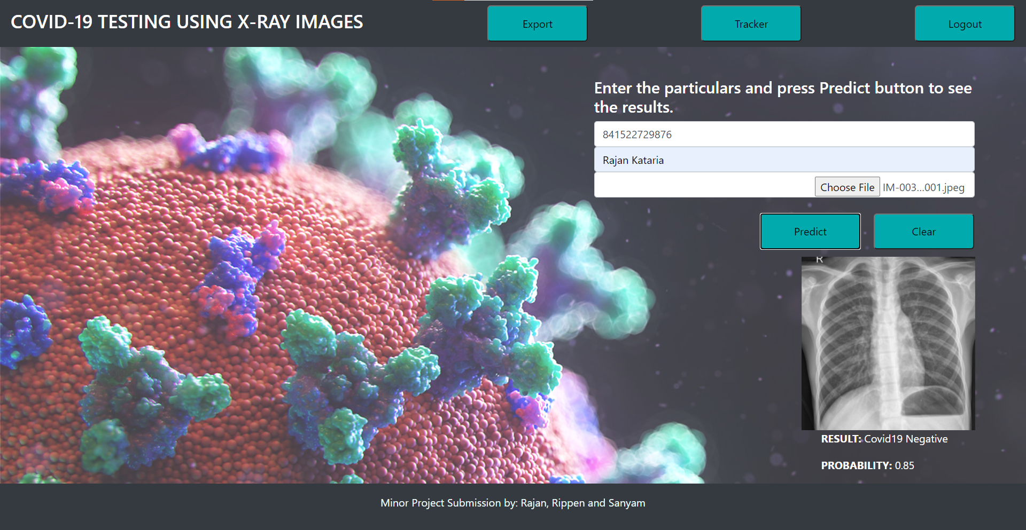
Web Application: COVID-19 Detector

Slide 21
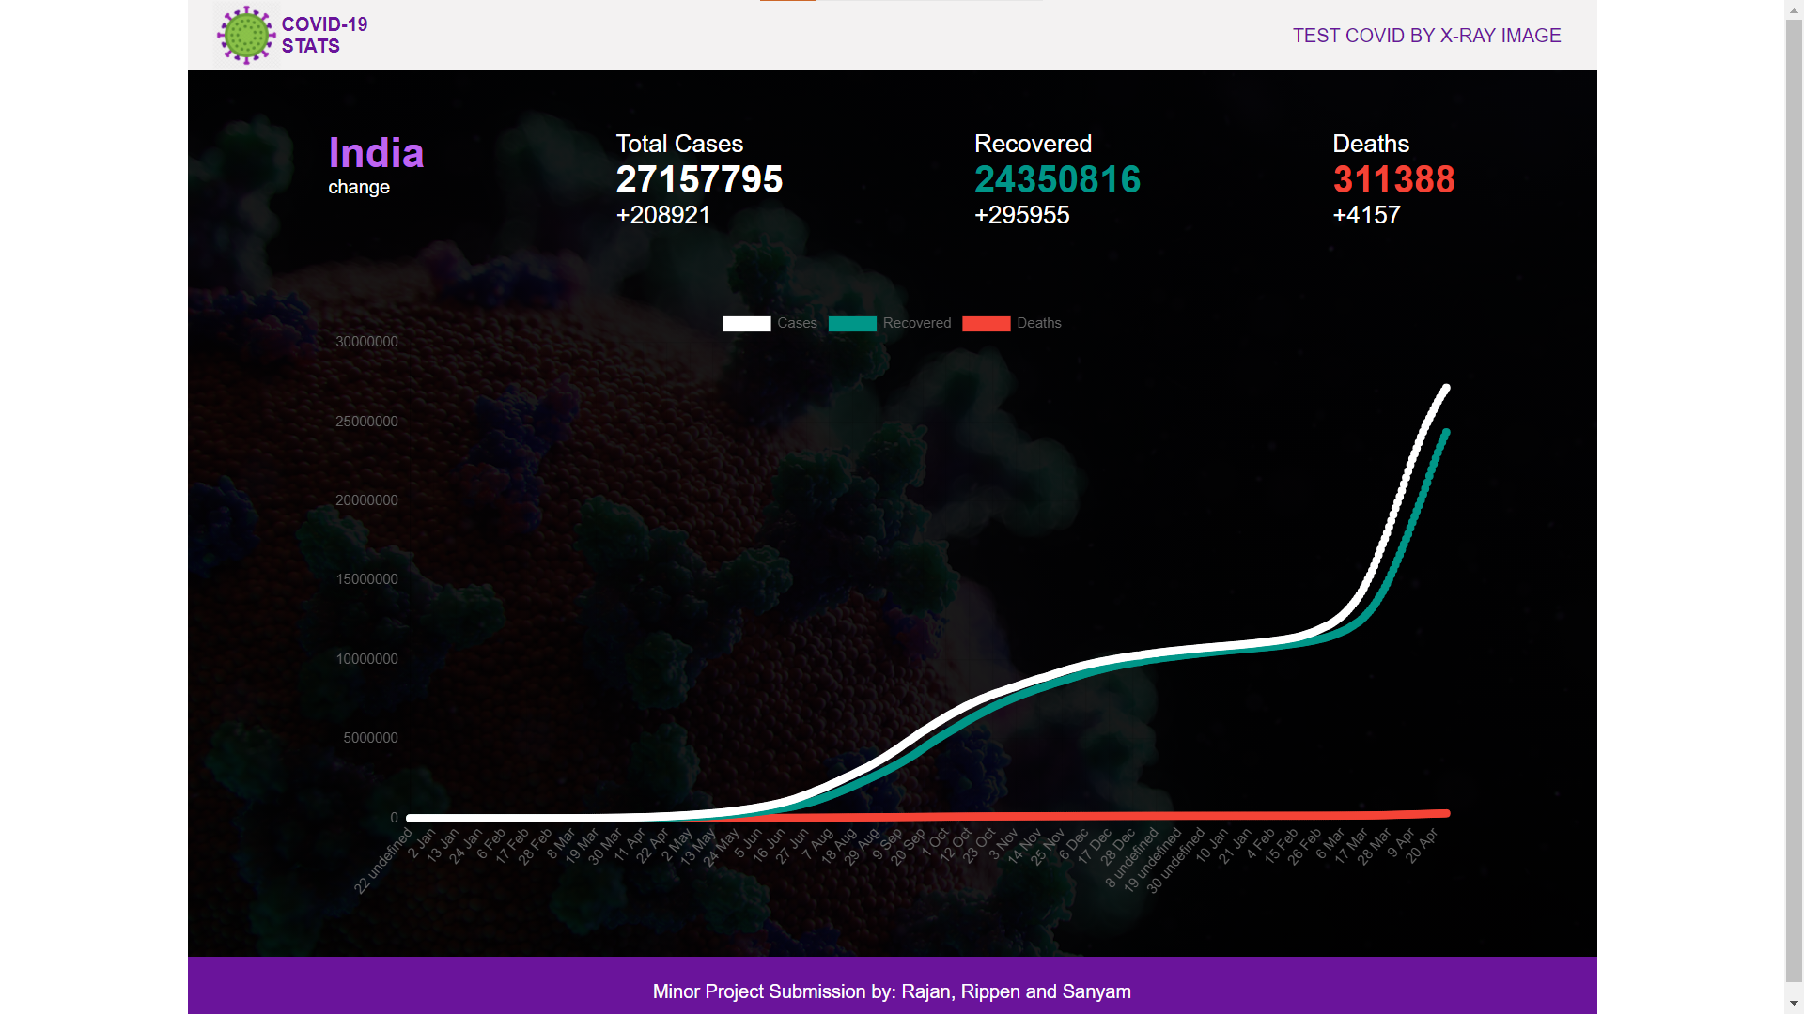
Web Application: COVID-19 Tracker

Slide 22
Suggestions for Future Works
A limitation of the study is the use of a limited number of COVID-19 X-ray images. We intend to make our model more robust and accurate by using more such images from our local hospitals. In the future, we intend to validate our model by incorporating more images.
This developed model can be placed in a cloud to provide diagnosis instantly and to help rehabilitate affected patients immediately. This should reduce clinician workload significantly.
We can address CT images for COVID-19 detection and compare the obtained results with the proposed model trained using X-ray images.

Slide 23

Thank You
and
Any of the suggestions are most welcomed!

